Slide 1
The Other Languages
Don’t panic!
https://github.com/JimWright4089/FIRSTWorkshops

Slide 2
Intro
Things covered in this class:
Microsoft MakeCode
CMU RobotC

Slide 3
I do not like Block Programing
I do not like Block Programing
I do not like it with a ring
I do not like it while I sing
I will not write it for anything
https://github.com/JimWright4089/FIRSTWorkshops

Slide 4
I do not like Block Programing
I do not like with my cat
I do not like it on a mat
I want to swat it like a gnat
It annoys me like a flying bat
https://github.com/JimWright4089/FIRSTWorkshops

Slide 5
I do not like Block Programing, why?
The most important tool a programmer uses is Version Control (GitHub)
You can see the differences between version of your code.
You can find a something in a very lary project.
https://github.com/JimWright4089/FIRSTWorkshops

Slide 6
I do not like Block Programing, why?
https://github.com/JimWright4089/FIRSTWorkshops

Slide 7
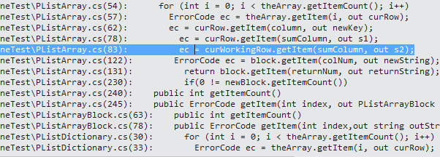
I do not like Block Programing, why?
https://github.com/JimWright4089/FIRSTWorkshops

Slide 8
Microsoft MakeCode
Under the settings you will find tools to set the names of the phones.
<team number>-DS for Driver station
<team number>-RC for Robot Controller
Spare phones user letters between the team number and the –XX. Like 4444-B-RC

Slide 9
Setting up the phones
Connect the Driver station to a joystick, or hub with two joysticks connected to it, through a OTG cable.
Connect the Robot Controller to the Robot through a Mini B to Micro B cable.

Slide 10
Setting up the phones
The Robot controller needs a Robot Configuration to run.
When you name things in the configuration, you must use those names in the programs.

Slide 11
Programming
You have a bunch of ways to program your robot.
Block
OnBot
Andriod Studio

Slide 12
Block and OnBot connection.
You will enable another WIFI connection to the Robot Controller
Use the Program and Manage menu item.
From this panel you will see the WIFI name and WIFI key for the robot controller

Slide 13
Block and OnBot connection.
You will enable another WIFI connection to the Robot Controller
Use the Program and Manage menu item.
From this panel you will see the WIFI name and WIFI key for the robot controller.
Point your browser to the IP address on the RC. Something like:
http://192.168.49.1:8080

Slide 14
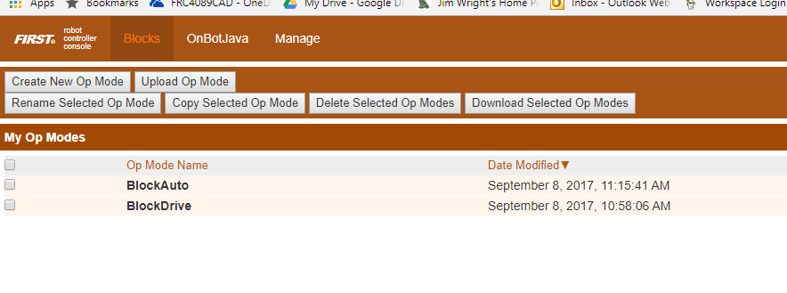
Block
Screen:

Slide 15
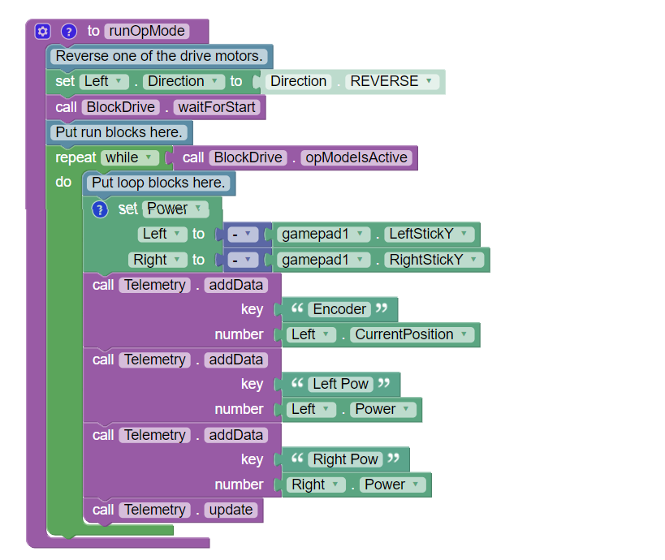
Block

Slide 16
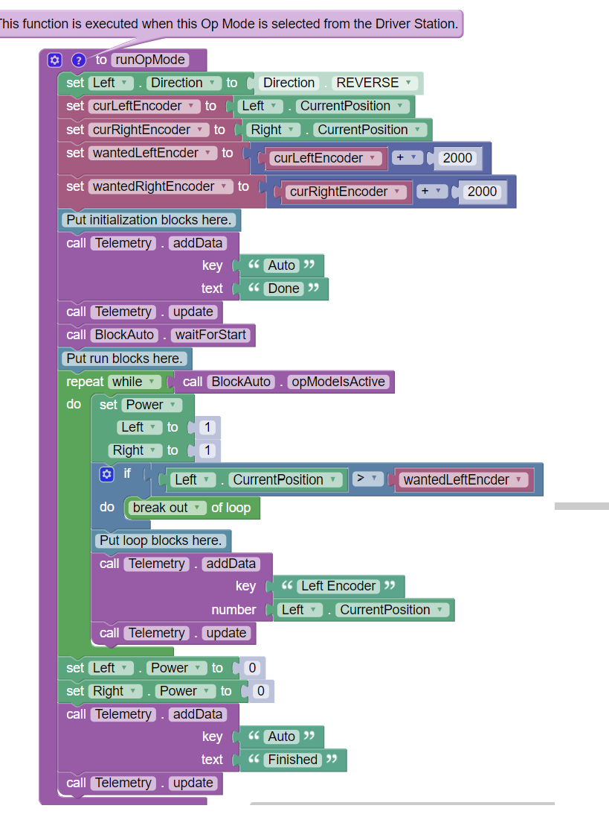
Block

Slide 17
OnBot
Standard Java, just on the robot!

Slide 18
OnBot
rightMotor = hardwareMap.dcMotor.get("Right");
rightMotor.setDirection(DcMotor.Direction.REVERSE);// Set to FORWARD if using AndyMark motors
rightMotor.setMode(DcMotor.RunMode.STOP_AND_RESET_ENCODER);
rightMotor.setMode(DcMotor.RunMode.RUN_WITHOUT_ENCODER);
waitForStart();
runtime.reset();

Slide 19
OnBot
while (opModeIsActive()) {
Integer rightEnc = rightMotor.getCurrentPosition();
telemetry.addData("Status", "Run Time: " + runtime.toString());
telemetry.addData("R Enocder", rightEnc.toString());
telemetry.update();
leftMotor.setPower(-gamepad1.left_stick_y);
rightMotor.setPower(-gamepad1.right_stick_y);

Slide 20
Color Sensor
Run the Color Sensor Example

